Slide 1
HyveMobile Tableau Workbook
File created on: 2019/06/14 11:31:43 AM

Slide 2
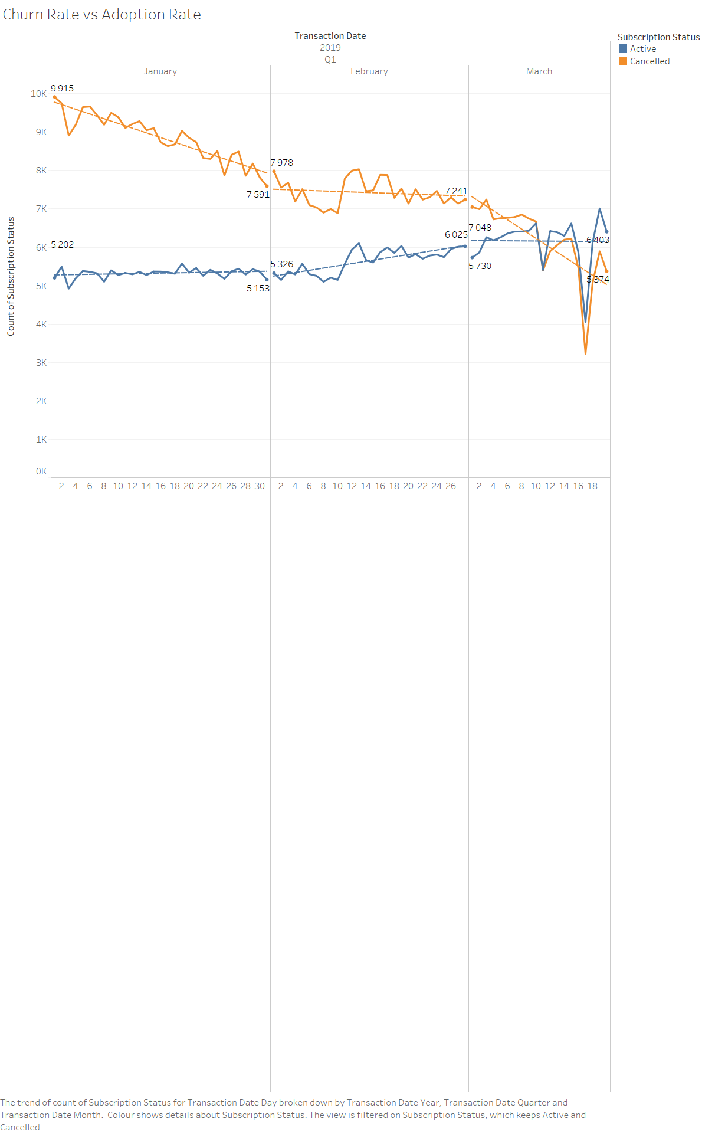
Overall Cancellations are declining, while Active subscriptions are growing.

Slide 3
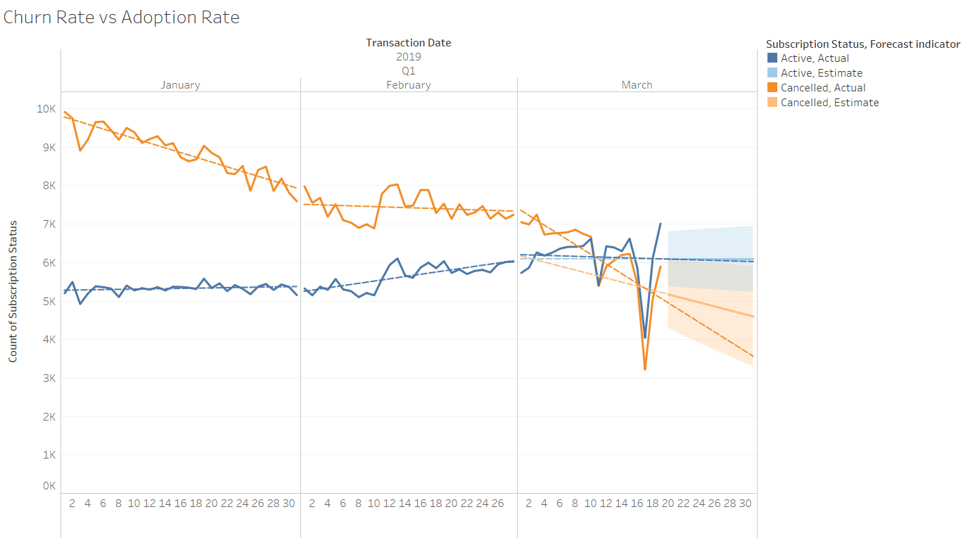
Forecasting this forward, the active subscribers should continue to increase slightly, while cancellations drop.

Slide 4
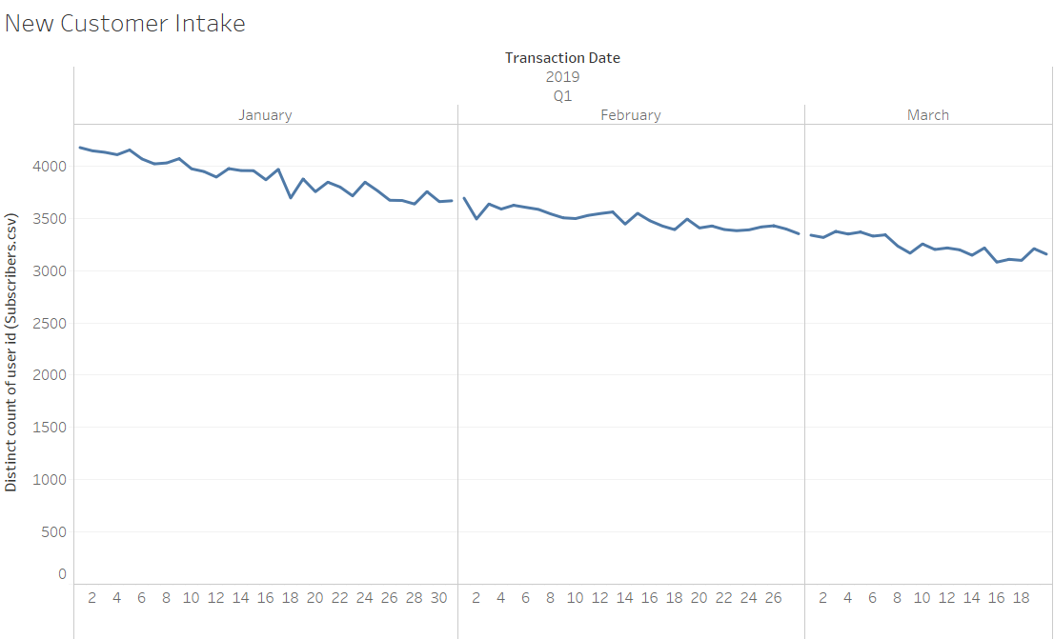
However, the adoption rate of new unique customers is declining.

Slide 5
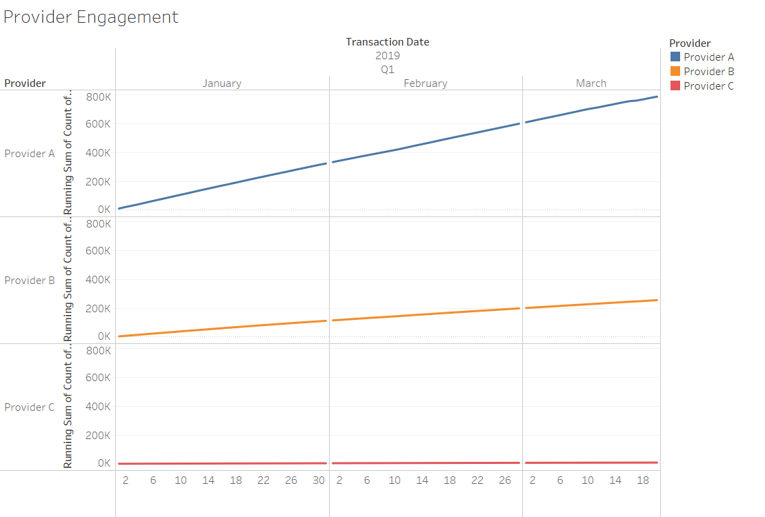
Taking a look at our providers: Provider A transactions are outgrowing provider B & provider C

Slide 6
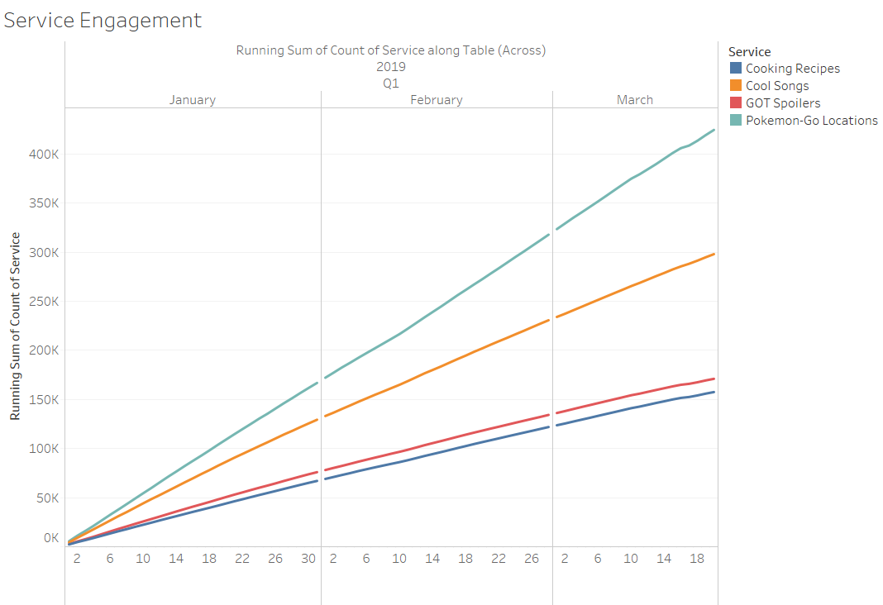
Pokemon Go is outperforming the other services Hyvemobile provides as well.

Slide 7
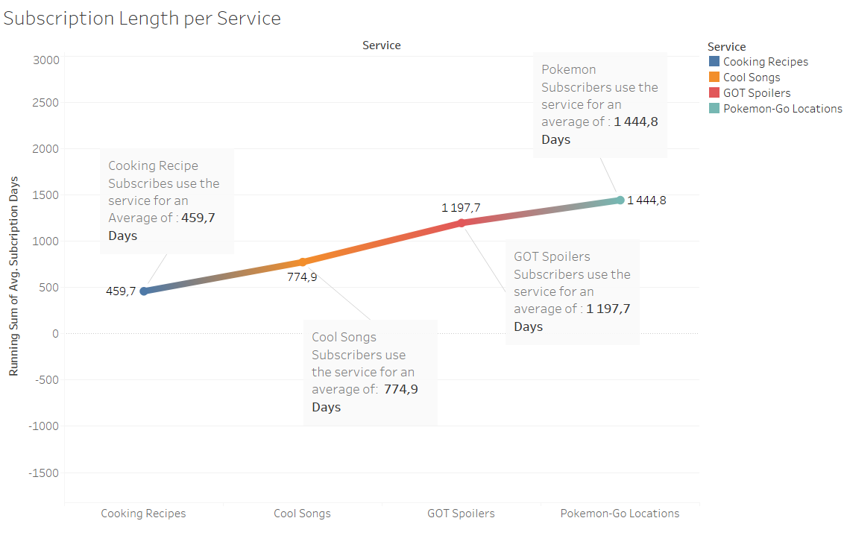
A deeper look into services illustrates that user retention for Pokemon Go service is nearly triple that of the Cooking Recipe service

Slide 8
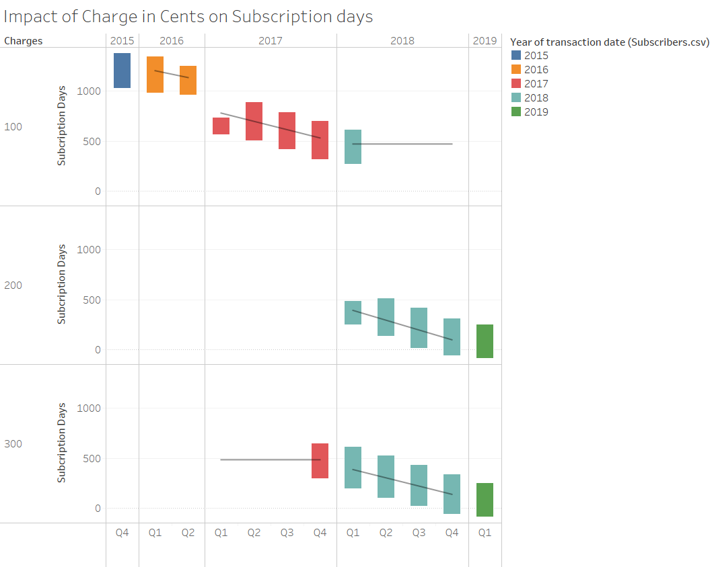
As charges have increase from 2015 to 2019, it has impacted the subscription duration of subscribers.

Slide 9
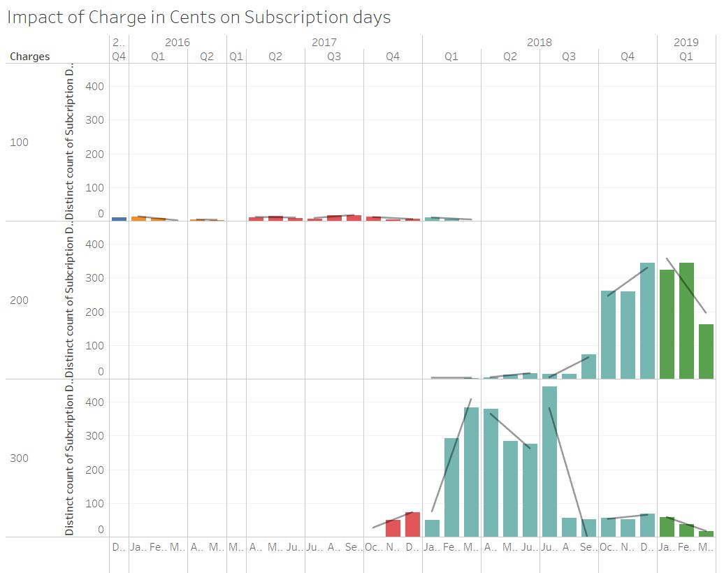
But on closer inspection we realize that 2018 and 2019 has yielded higher subscriber turnout - regardless of their shorter subscriber days. More subscribers . Less lengthy subscriptions.

